Slide 1
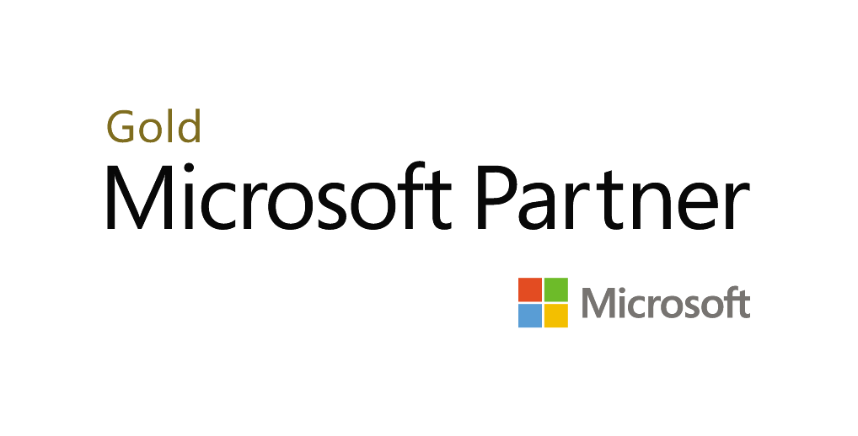
Securing Microsoft 365 for Users
Presented by Kevin Brosseau

Slide 2
Webinar Agenda
How do I know I’ve been compromised?
What to expect if your account has been compromised.
“My system has been compromised. Now what?”
How to help prevent this from happening again.

Slide 3
How do I know I’ve been compromised?

Slide 4
How do I know I’ve been compromised?
Some ways you can tell if you’ve been compromised include:
Emails from people asking why you’ve sent this specific email?
This is one of the key symptoms of a compromised account. People you normally email may have responded asking “Why did you send me this email?”.
The email in question could be riddled with spelling and grammatical mistakes, that you may not normally make.
Lots of messages being sent out that you do not recognize sending out.
Your Sent items folder might be filled with emails that you do not recognize having sent.
This is a possible symptom, but some malicious entities who have gained access to a user’s account may account for this by sending out an email in bulk to many people.
Emails not coming in when they should be.
Someone who has gained access to an account may have set up rules to delete new email messages coming into your mailbox, after forwarding the incoming emails to their own private email accounts of course.

Slide 5
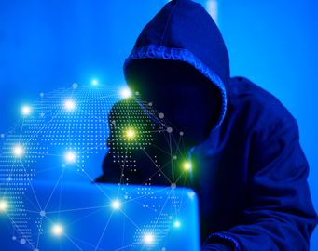
What to expect if your account has been compromised.

Slide 6
Brand new forwarding rules
You might see a bunch of emails from people you know asking if you’ve sent this email.
You might notice a lot of messages in sent items?
You might not be able to send out email because of too many emails being sent out in a short period of time.
You might get NDR (non-delivery receipts/responses) about emails that you have not sent out.

Slide 7
Spam, and not the kind sold in stores
When an account is compromised, often the email account will be used to send out spam.
Primarily, they will start sending out email to people in the address book.
It can be a series of emails, or a single email with users added in via BCC.
If you see spam being sent to you or being sent by your account, alert your administrator or IT department immediately.

Slide 8
Snooping around
If you store stuff in OneDrive, chances are someone who has gotten access to your account will start looking into those files.
If you see activity that you don’t recognize, like the last accessed date changing to a very recent time, then it might be time to speak with your IT department or Administrator.

Slide 9
“My Account has been compromised. Now what?”

Slide 10
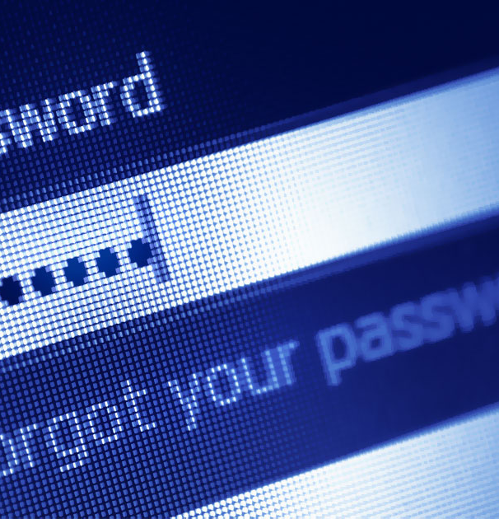
Change your password and sign out of everything
First things first, is to change your password for Microsoft 365.
You may need to reach out to your admin to change your password.
You then want to sign out of all Microsoft 365 services.
You can do so as a user by going to these two links
https://login.microsoftonline.com/logout.srf
https://login.live.com/logout.srf
You can have your admin sign you out of all services as well from the admin portal.
Admins: Go to the admin portal > Users > Active User > Click on the user’s name > Sign-out > “Sign out of all sessions”
It can take up to 15 minutes to be fully signed out.
This also signs users out of the apps.
This Photo by Unknown Author is licensed under CC BY-SA

Slide 11
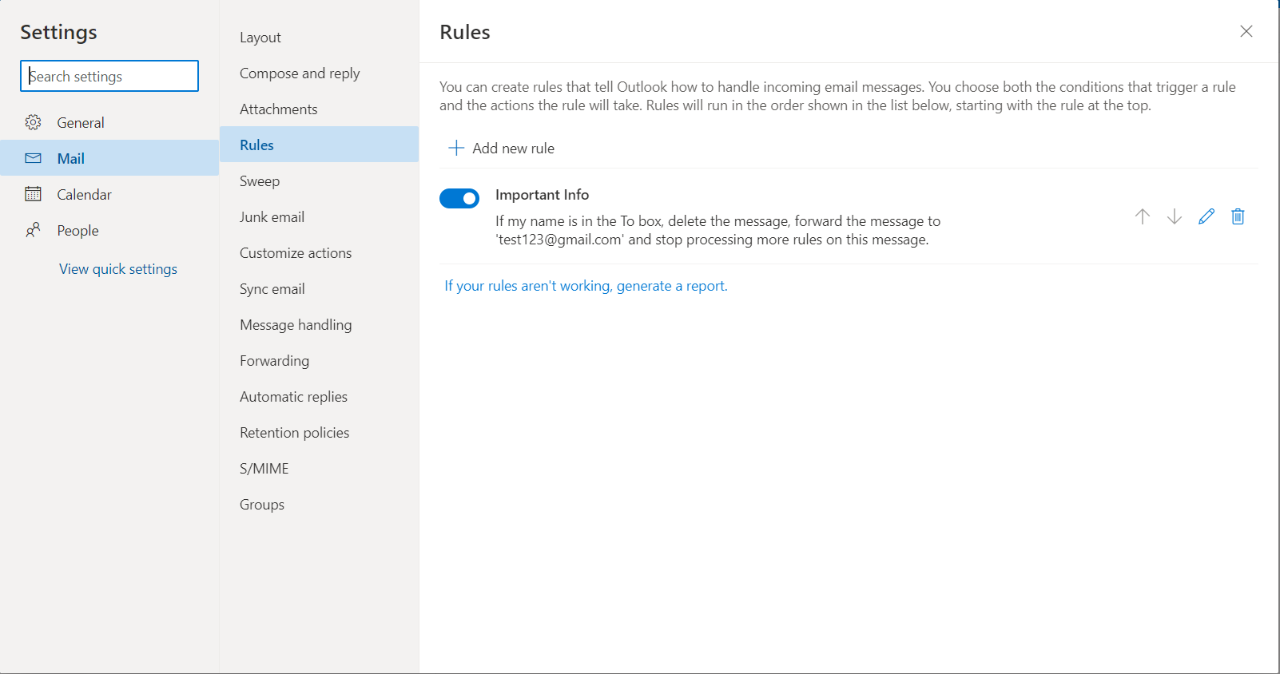
Check for unusual email rules
Sign back into Office on the Web and open up Outlook on the web.
Click the gear icon at the top right and then click “view all Outlook settings”
Click on rules and review whatever inbox rules are set up.
Remove any rules you do not recognize or look odd to you.

Slide 12
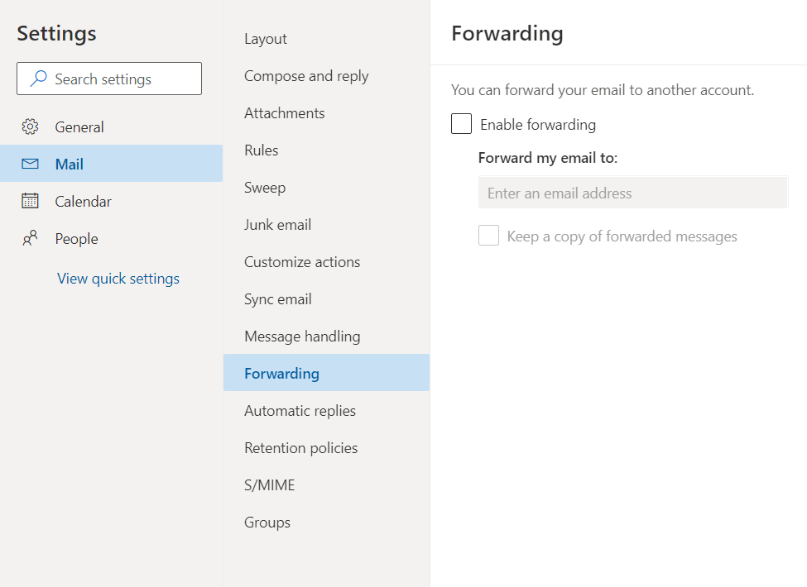
Is forwarding enabled?
Click on Forwarding and see if Forwarding is enabled and if emails are being forwarded to an unrecognized email address.
If so, then make sure “enable forwarding” is not selected.

Slide 13
Check your sent items folder
If the forwarding rules don’t have the sent message selected for deletion, then check the Sent Items folder.
A lot of times, the emails will be sent out en mass via BCC (Blind Carbon Copy).
If they have been set for deletion, then you can still check the deleted items folder, and the recoverable items folder.
Your Admin might need to run some eDiscovery to look for deleted messages.

Slide 14
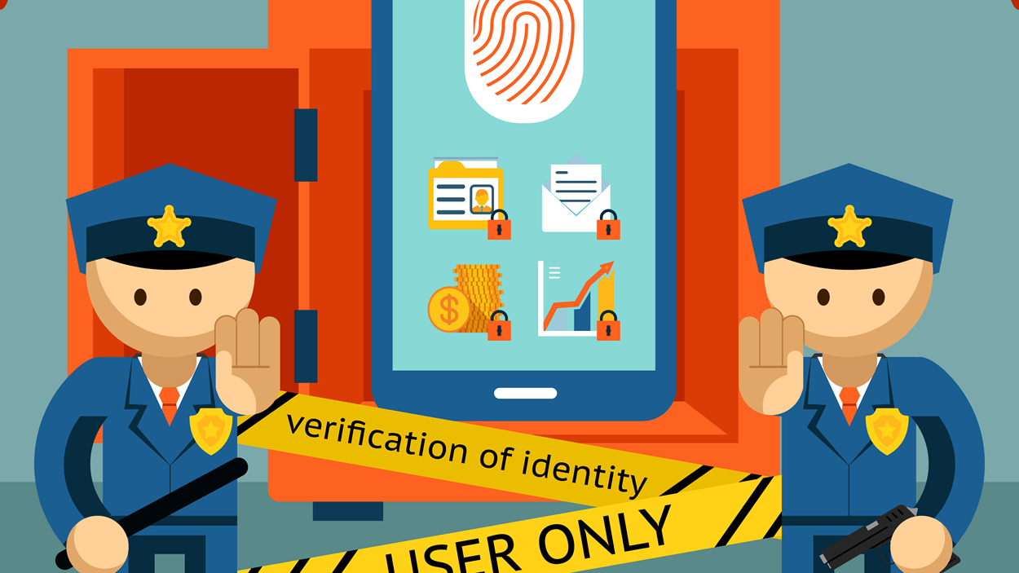
How do I prevent this happening again?
This Photo by Unknown Author is licensed under CC BY

Slide 15
Enable Multi-Factor Authentication
The biggest way to protect yourself from having this happen again is to enable Multi-Factor Authentication. Speak with your Admin about setting it up for your account!
Multi-factor Authentication can be irritating for users, but the benefits far outweigh the negatives.
MFA can be performed through Mobile Device texting, phone calls, or Authenticator Apps like the Microsoft Authenticator App or Authy.

Slide 16
Change passwords regularly
Using different passwords for various services is a great way to protect yourself.
Changing your password regularly prevents old passwords from being known and used.
Look at generating passwords through a password manager like LastPass, Dashlane, KeePassX
Keep your password complex, with a mixture of Capital and lowercase letters, numbers, and special symbols like an exclamation point or an @ symbol.

Slide 17
Be vigilant in reporting suspicious material
If you receive emails that do not look legitimate, engage your IT staff.
Your admin can report messages as Phishing or as Spam directly to Microsoft.
If your IT Staff have enabled the report phishing and report spam add-ins for Outlook, you can use those to report messages.

Slide 18
Learn to spot fake emails
As a user, there are ways that you can spot a fake email, here are some things to look out for.
Generic greetings or something like “Dear [your email or username] here”. There also might be a lack of personalization.
Improper Grammar is one of the easiest ways to spot a fake email, along with excessive uses of “please” or “kindly” if it’s not expected.
File names in the subject line, usually something related to a .pdf or some sort of “invoice”, especially if there are no additional details.
These are a few ways to investigate the content of an email. In the next slide, we’ll go over a few other ways to investigate.

Slide 19
Learn to spot fake emails (continued)
Check the sending addresses.
You might need to expand details to see further, but attackers might spoof the username of the person, but not the actual email address, which might look similar to legitimate email addresses, but will be slightly “off”, like missing a .com and putting in .net or adding extra words.
Hover over links to see the URL’s
If a link looks suspicious, don’t click on it, but hover over the link.
Does the link look suspicious? Does it lead to where it’s supposed to? If not, then report the email to your IT Department or Administrator.

Slide 20
Questions?

